Slide 1
HOHI 1816, a case study of a boardgame-based learning design
Ruth Lemon and Richard Durham
ruth.lemon@auckland.ac.nz and r.durham@auckland.ac.nz
Notes:
2:00 - Welcome and context (5 min)
2:05 - Version 1: the trivial pursuit (5 min)
2:10 - Introduce version 2: narrative version (5 min)
2:15 - 10 minutes to play with the bits and bobs of chapter 1 (10 min)
2:25 - Learning design intent of version 2 (5 min)
2:30 - discussion
2:40 - ~fin~
ABSTRACT: In 2017, Ruth Lemon developed a board-game, ‘HOHI 1816’, which will soon be used with Graduate Diploma and Bachelor of Education students. Students were finding it difficult to consolidate their understandings of the critical histories around pre-Treaty Māori and Pākehā engagement, as demonstrated in summative assessment tasks. The game was developed to address this pedagogical need and to support students’ critical engagement with stories concerning the establishment of the first school next to Rangihoua pā, in the Bay of Islands. The aim was for students to experience the events and the dynamics of the relationships between Māori and Pākehā at the time. The game was redeveloped in 2018 in collaboration with Richard Durham, who supported the re-alignment of the game mechanics with key learning objectives.
This workshop is targeted at educators interested in incorporating games into curricula, interested in using the design process with students, and in novel and accessible ways to engage students in Māori history. Participants will get time to play a portion of the game, followed by discussion about the design choices and considerations participants should have when designing games that explore stories. Participants will leave with guide-lines on creating educationally-oriented games from our “lessons learned.” This workshop will provide an example of developing a game where learning objectives and gameplay are aligned, a vital pre-requisite skill in the development of learning games.

Slide 2
Introductions
What do “games in education” look like to you?
Notes:
5 minutes
https://bit.ly/3go0pJL

Slide 3
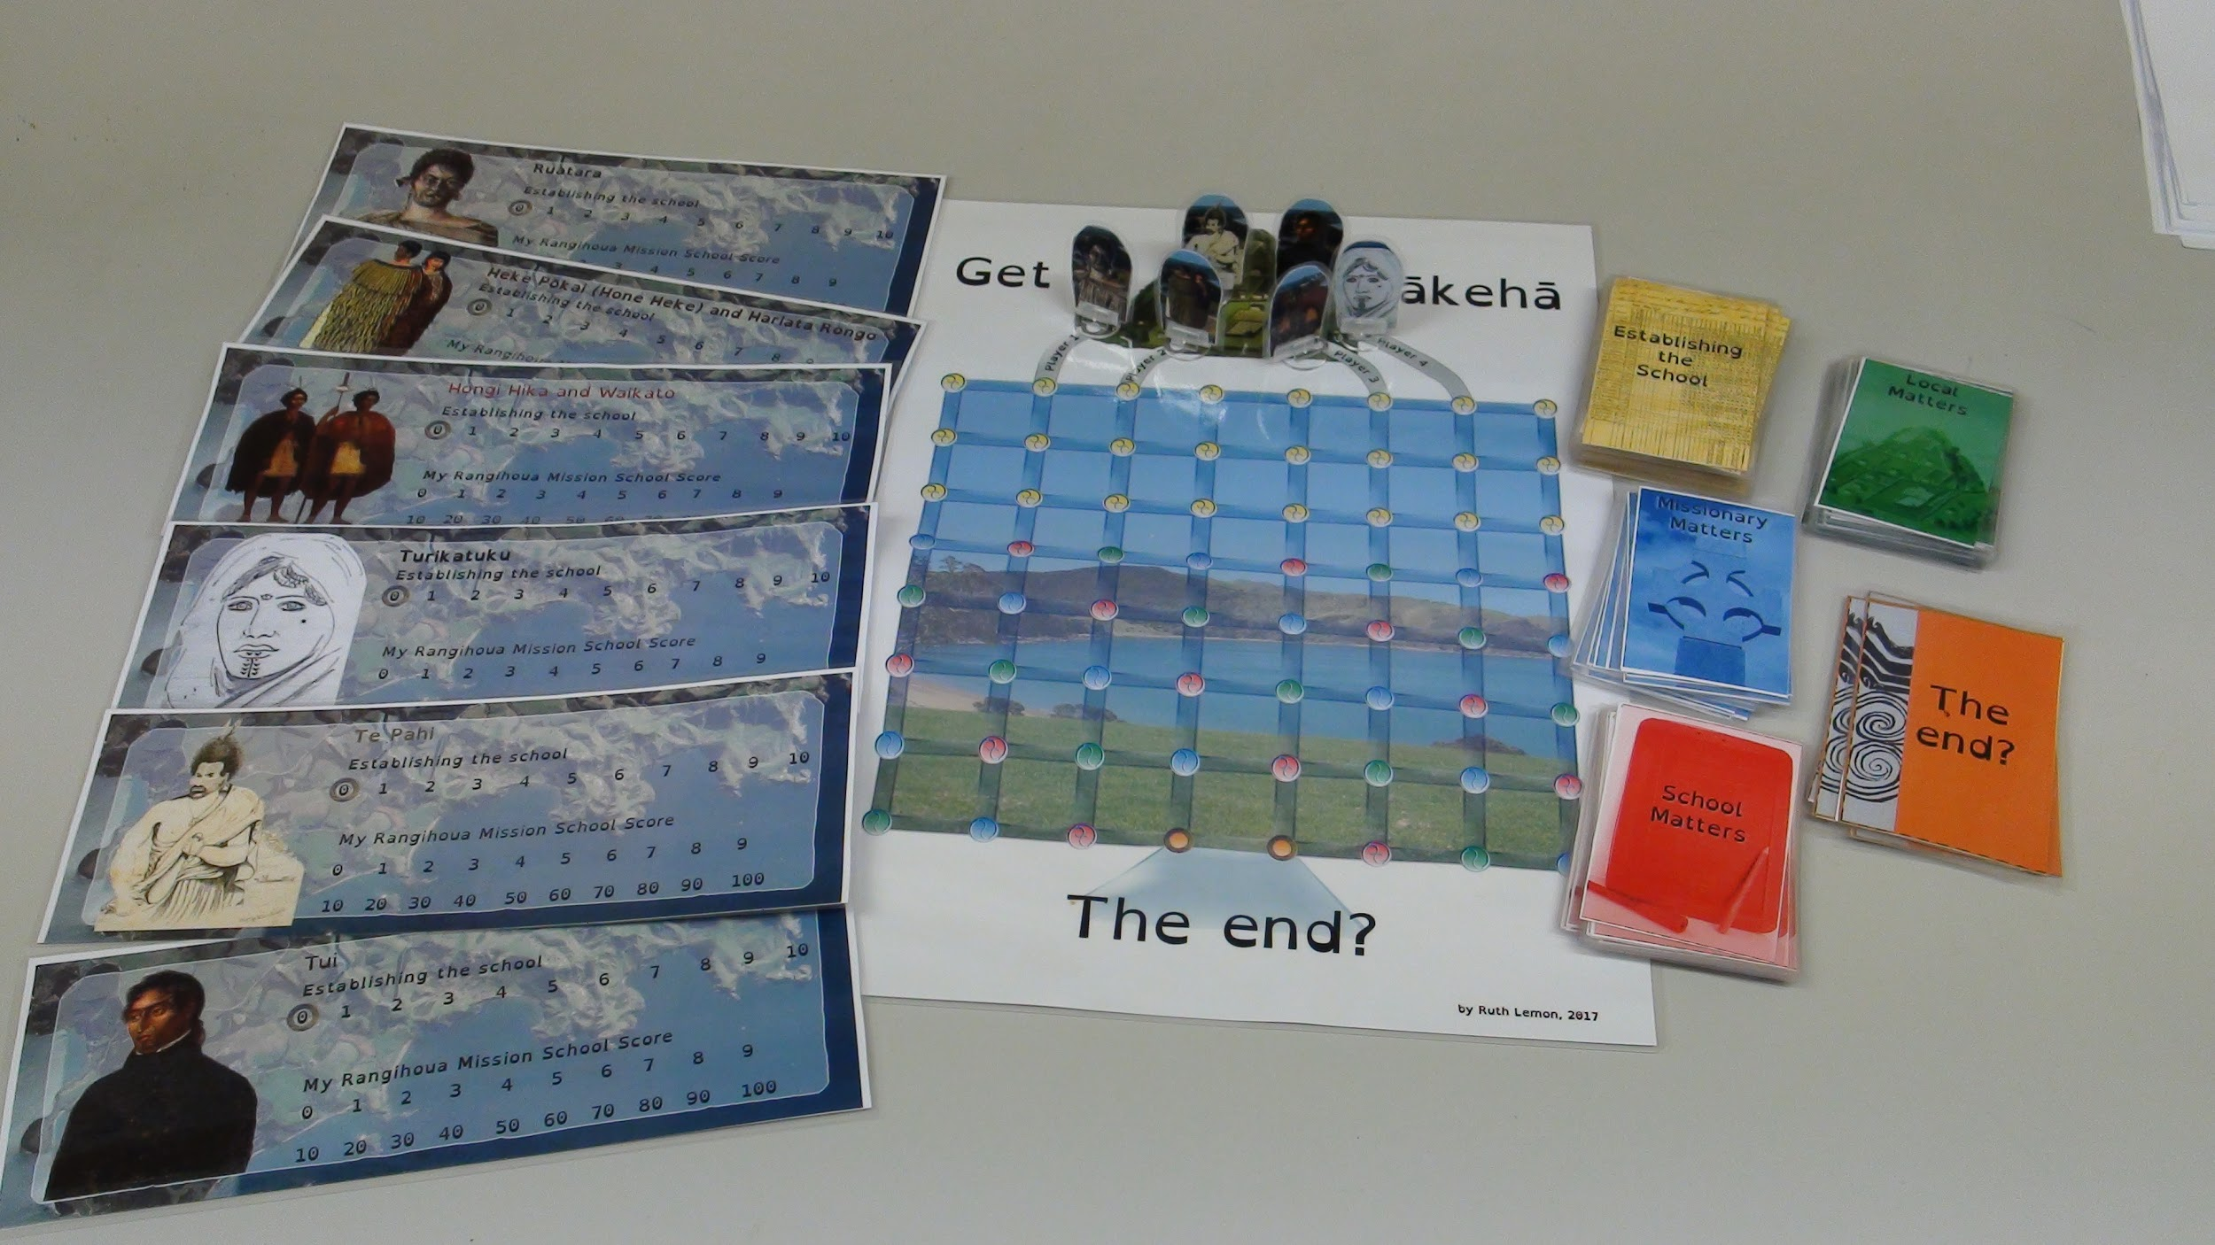
Notes:
Ru
First vision was a Trivial Pursuit format. (Describe).
Learning design
Used after lecture
For review, in groups
Factual recall and describe/explain questions
Engaging as competition, challenge of memory
Outcomes on assessment ask for critical thought, making connections between relationships.
This requires: Exploring the narrative of the ‘lecture’ and drawing relationships and testing them until they have a mental model.

Slide 4
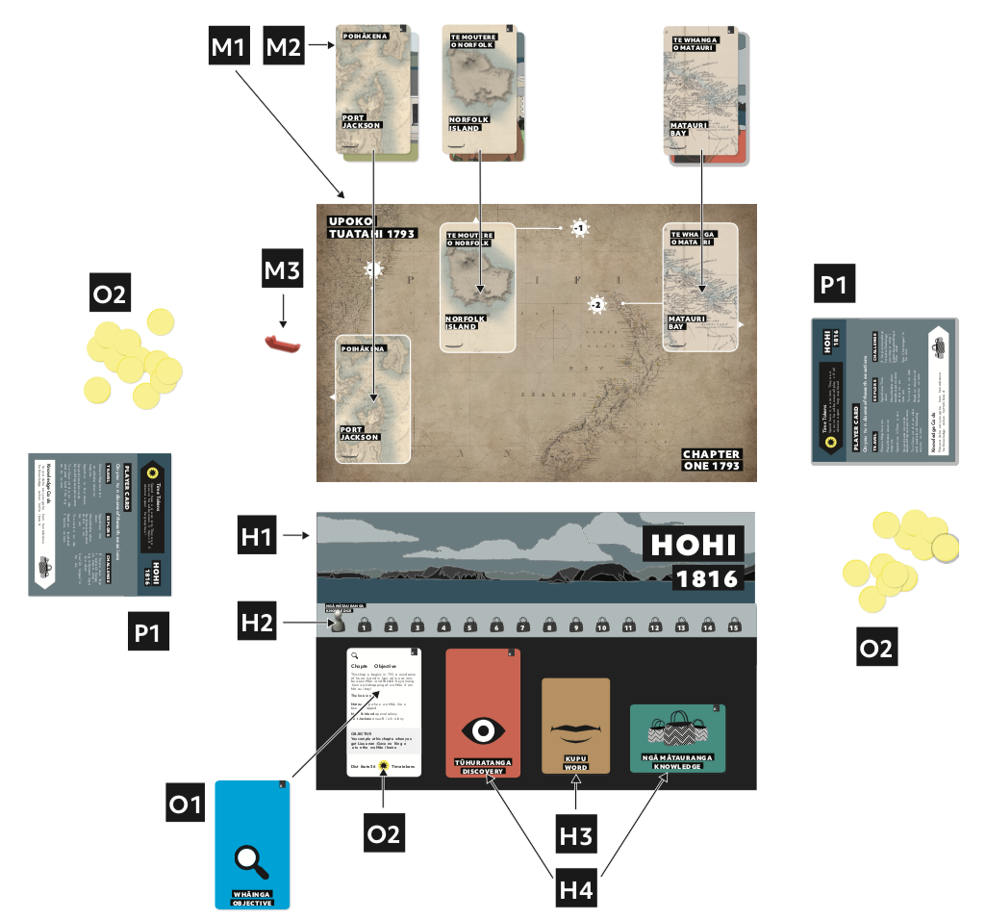
Notes:
Ri
A goal: Research, reframe, reclaim, pre-Treaty = Māori as active initiators not passive participants.

Slide 5
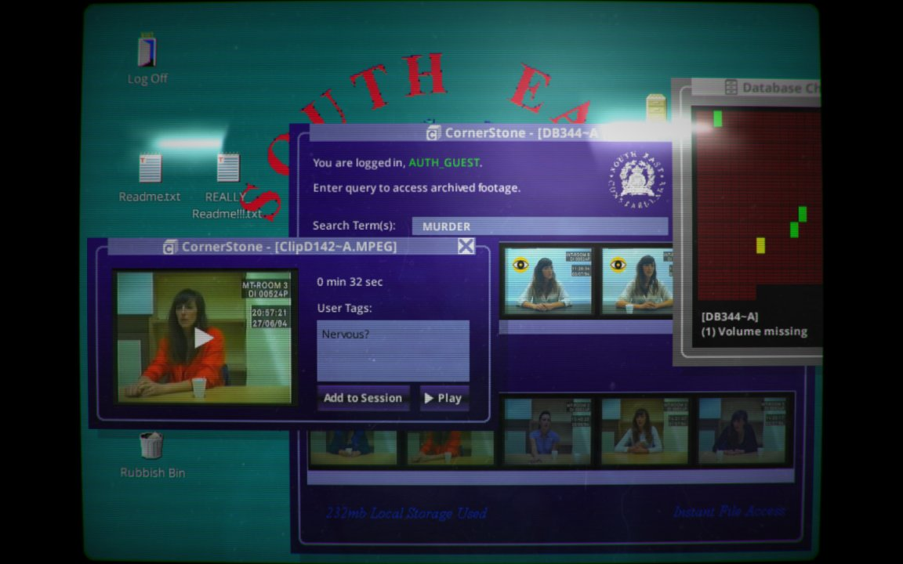
How can games get you engaged with stories?
Her story
By Sam Barlow
In 1994 a British woman was interviewed 7 times by the police about her missing husband.
herstorygame.com
Notes:
Ri

Slide 6
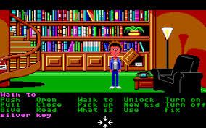
How can games get you engaged with stories?
Maniac Mansion
By Ron Gilbert
gamesnostalgia.com/en/game/maniac-mansion
Notes:
Rich

Slide 7
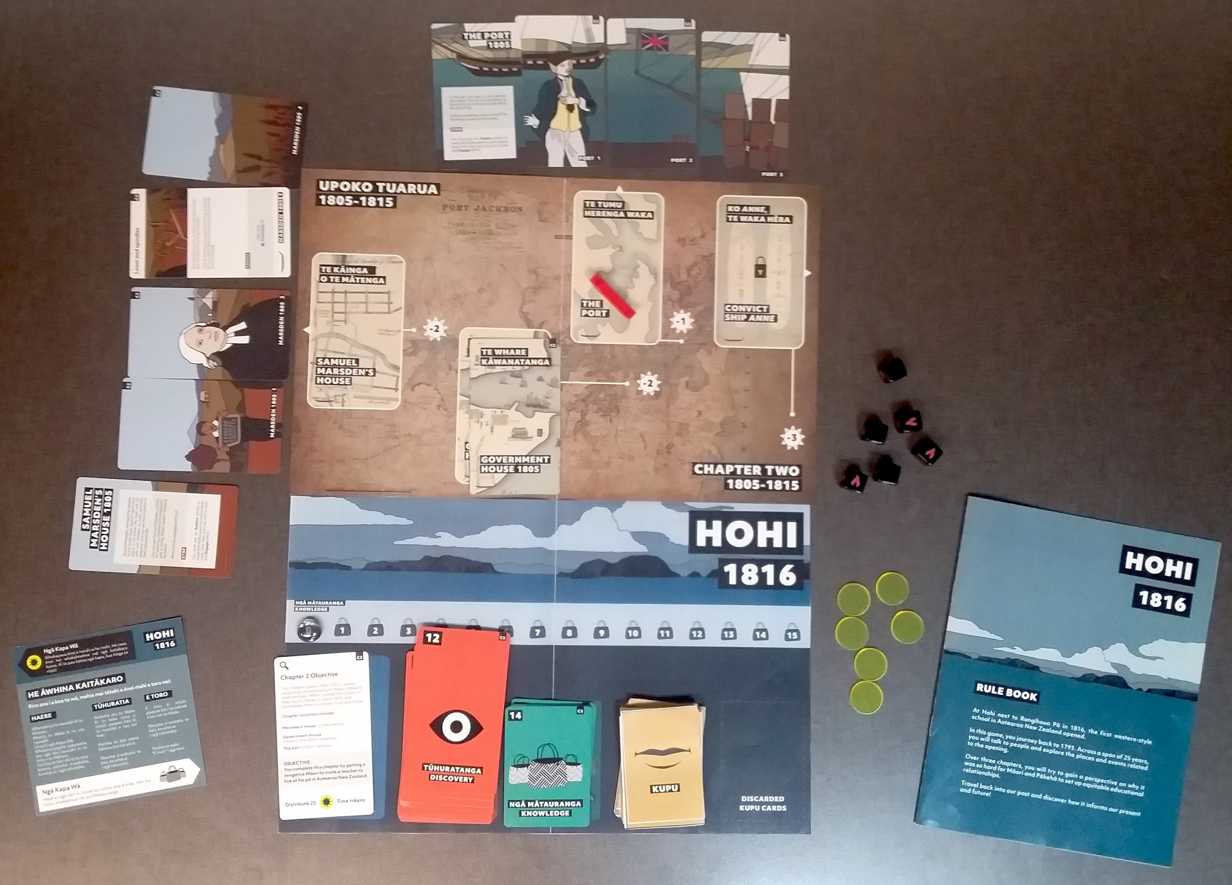
Notes:
Rich
This CAN look like the narrative game:
3 chapters, and students will explore locations and interact with characters to complete an objective. Like a point-and-click adventure game.

Slide 8
Our purpose
“Research, reframe, reclaim, pre-Treaty - Māori as active initiators not passive participants.”
Our meta-purpose
Examine a narrative game and the interactions within it
Identify principles of game design for learning and incorporating them into your curricula
Notes:
Ruth
2 min
Rules explanation and walkthru
10 min?

Slide 9
Play time

Slide 10
Playing chapter one - te upoko tuatahi
Guiding question:
What might be some explicit and implicit teaching in this game experience?

Slide 11
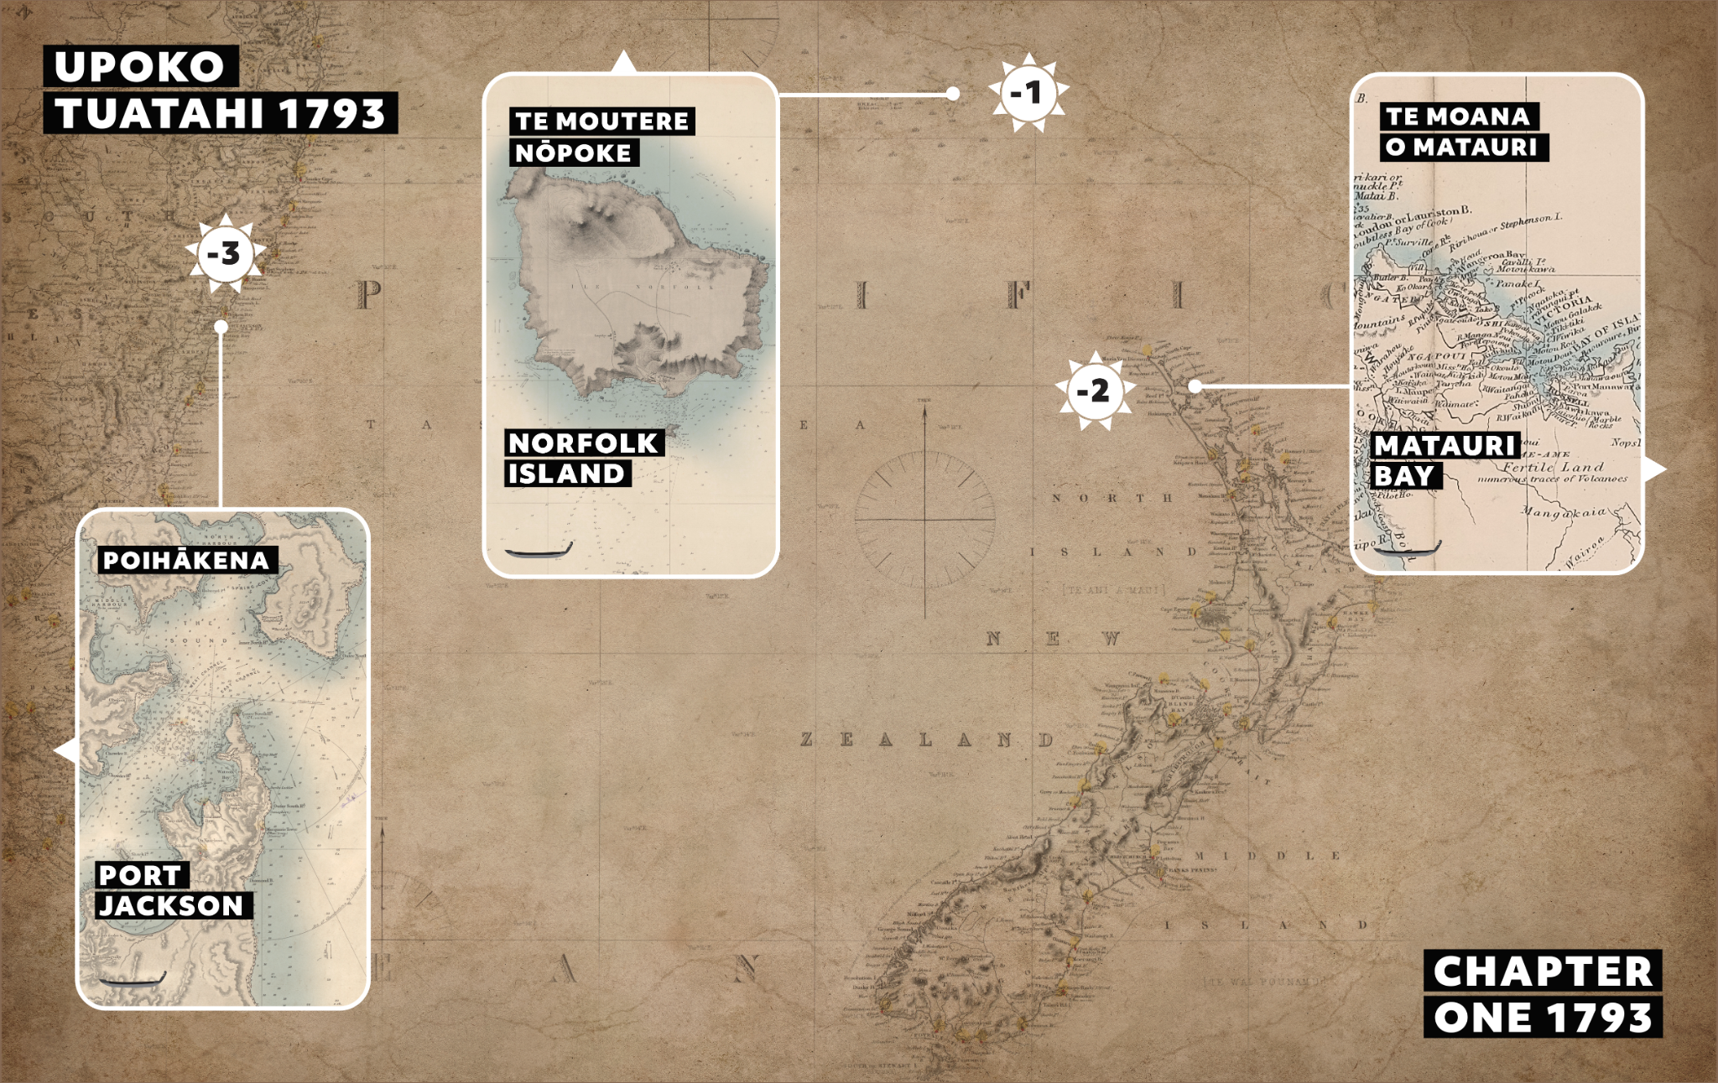
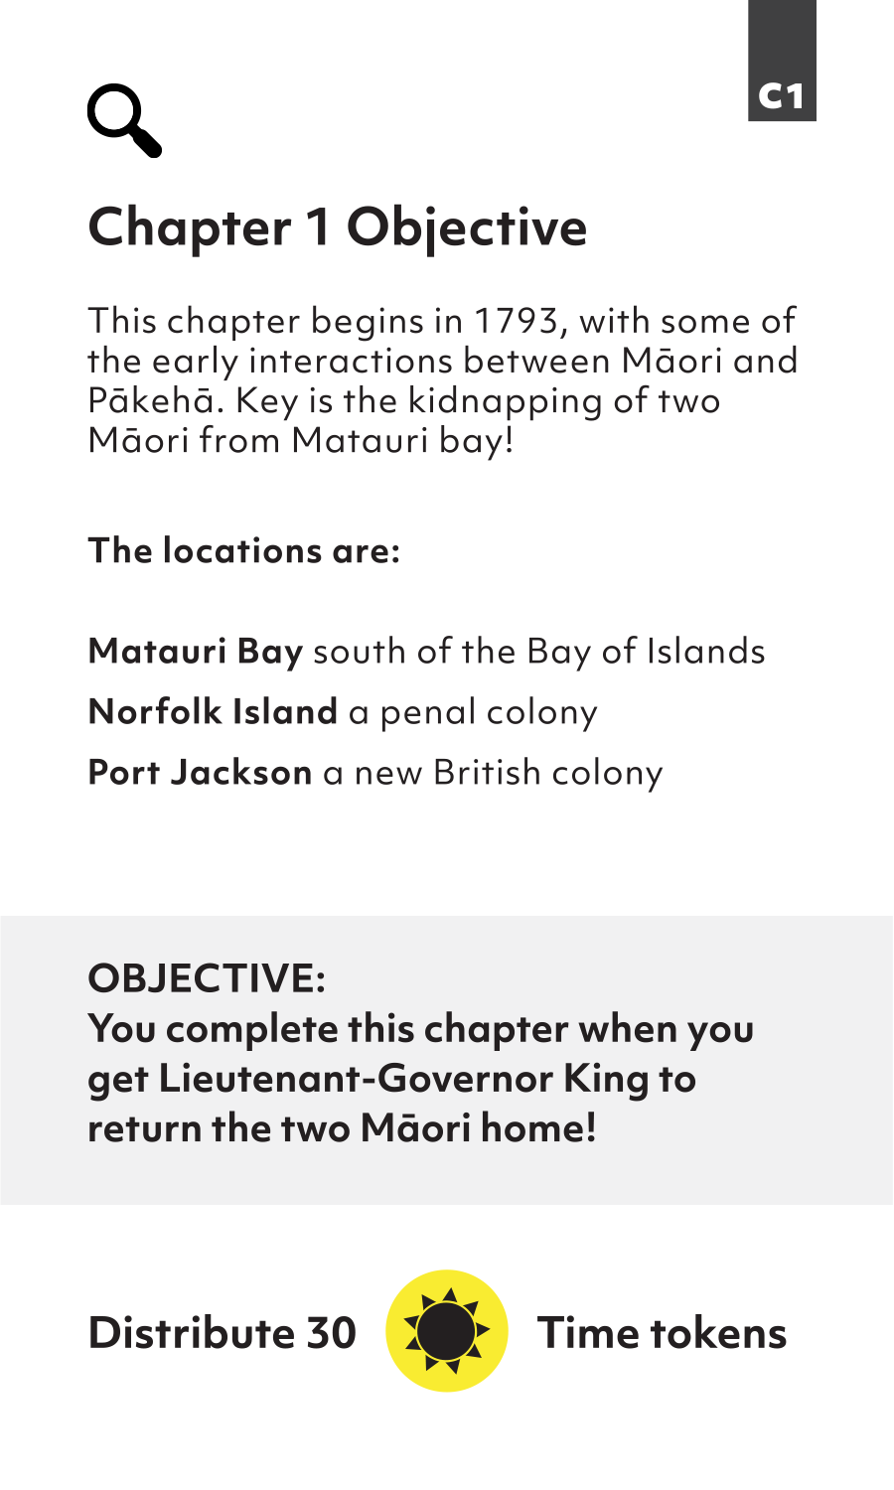
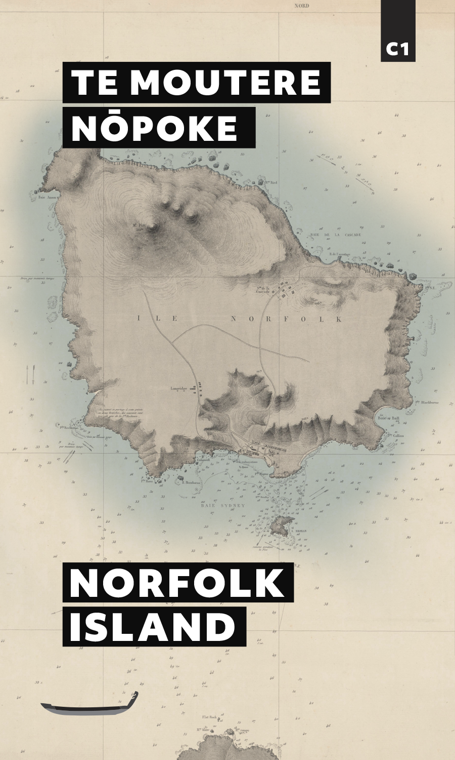
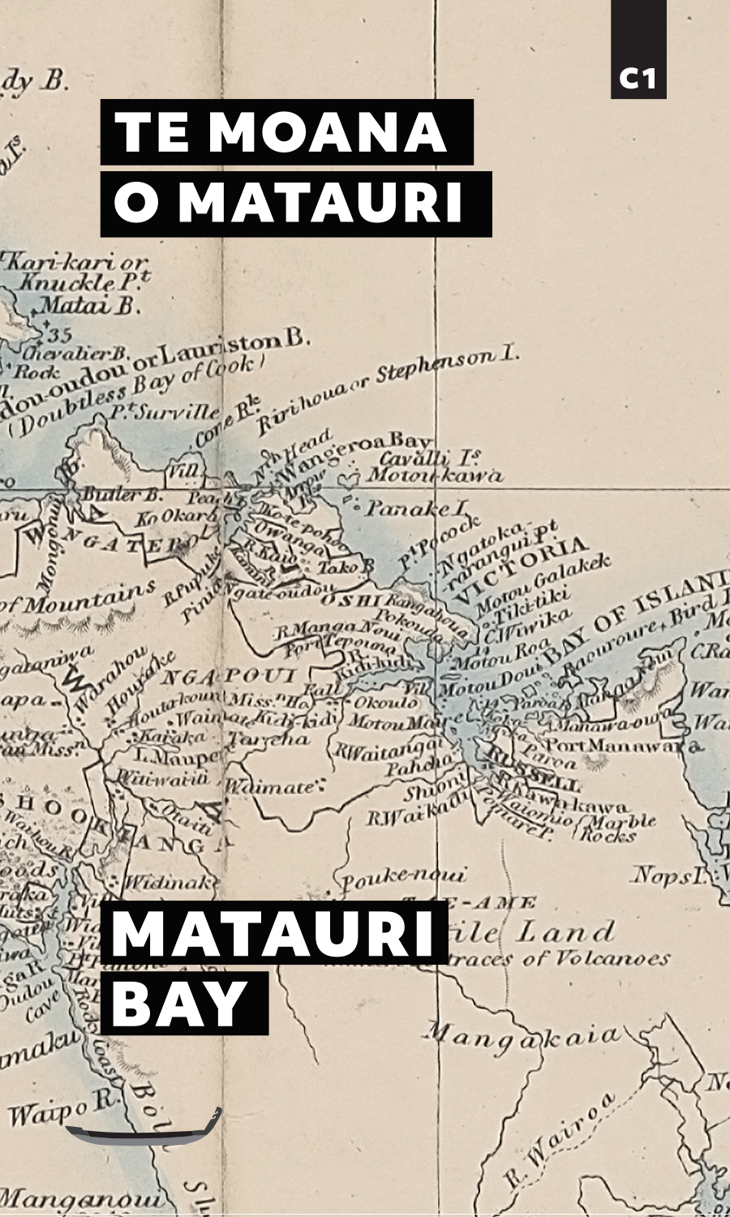
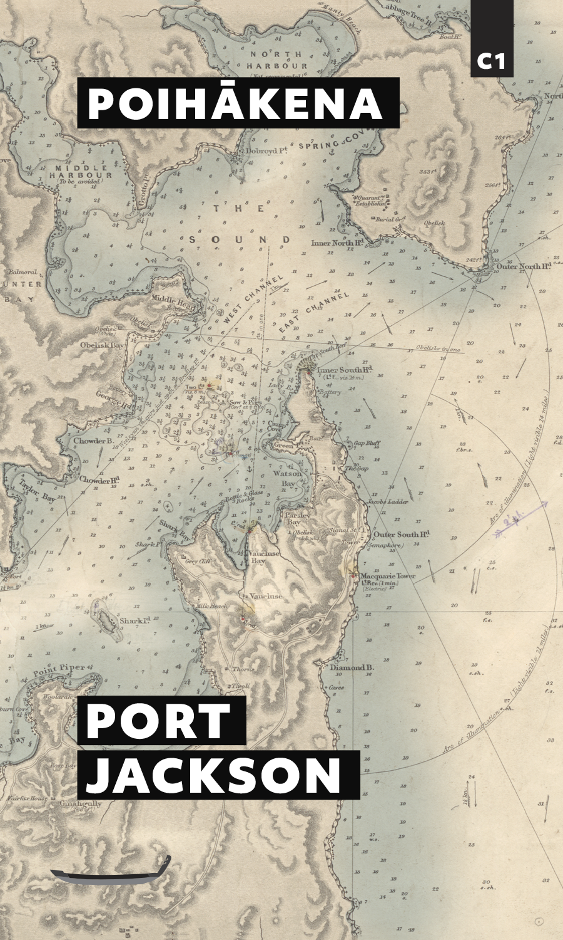
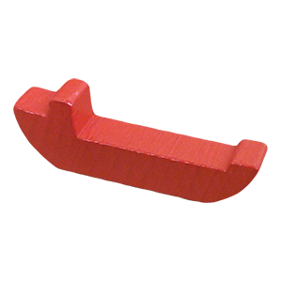


Slide 12
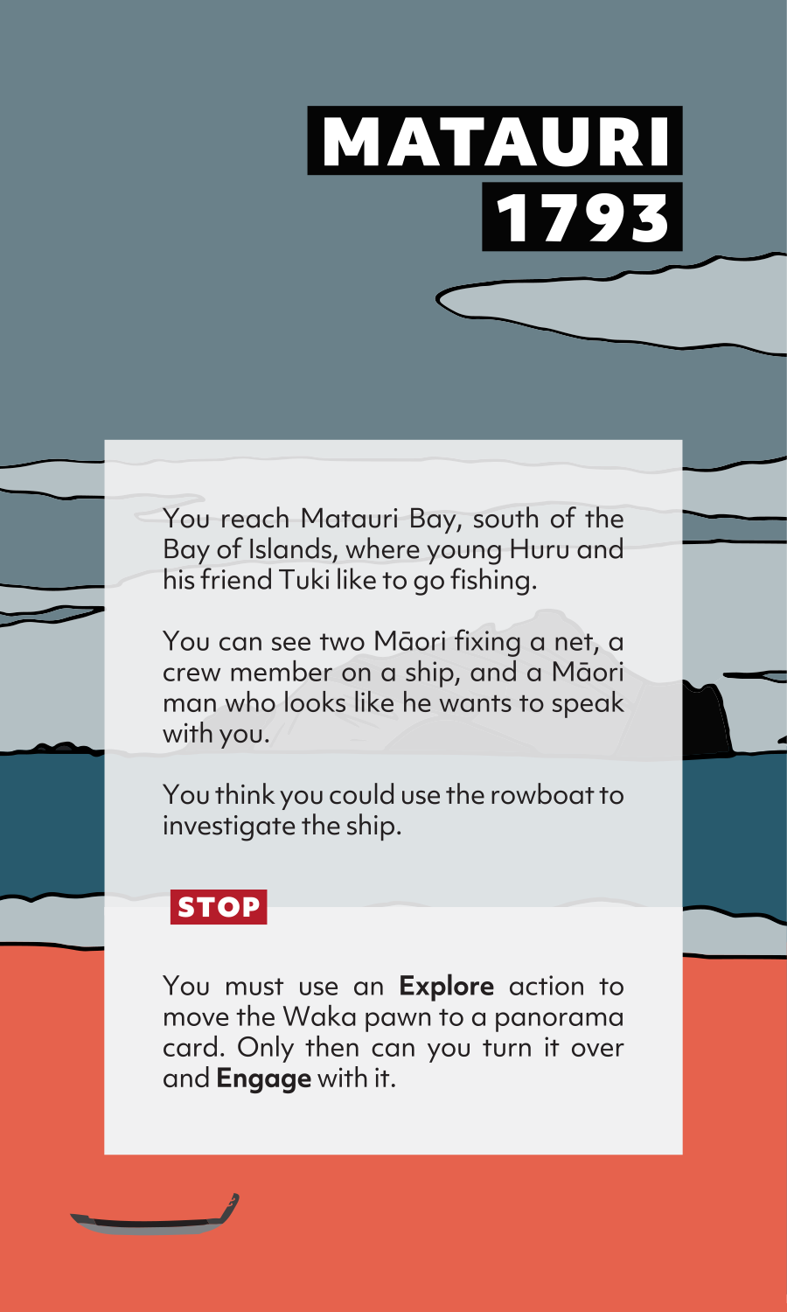
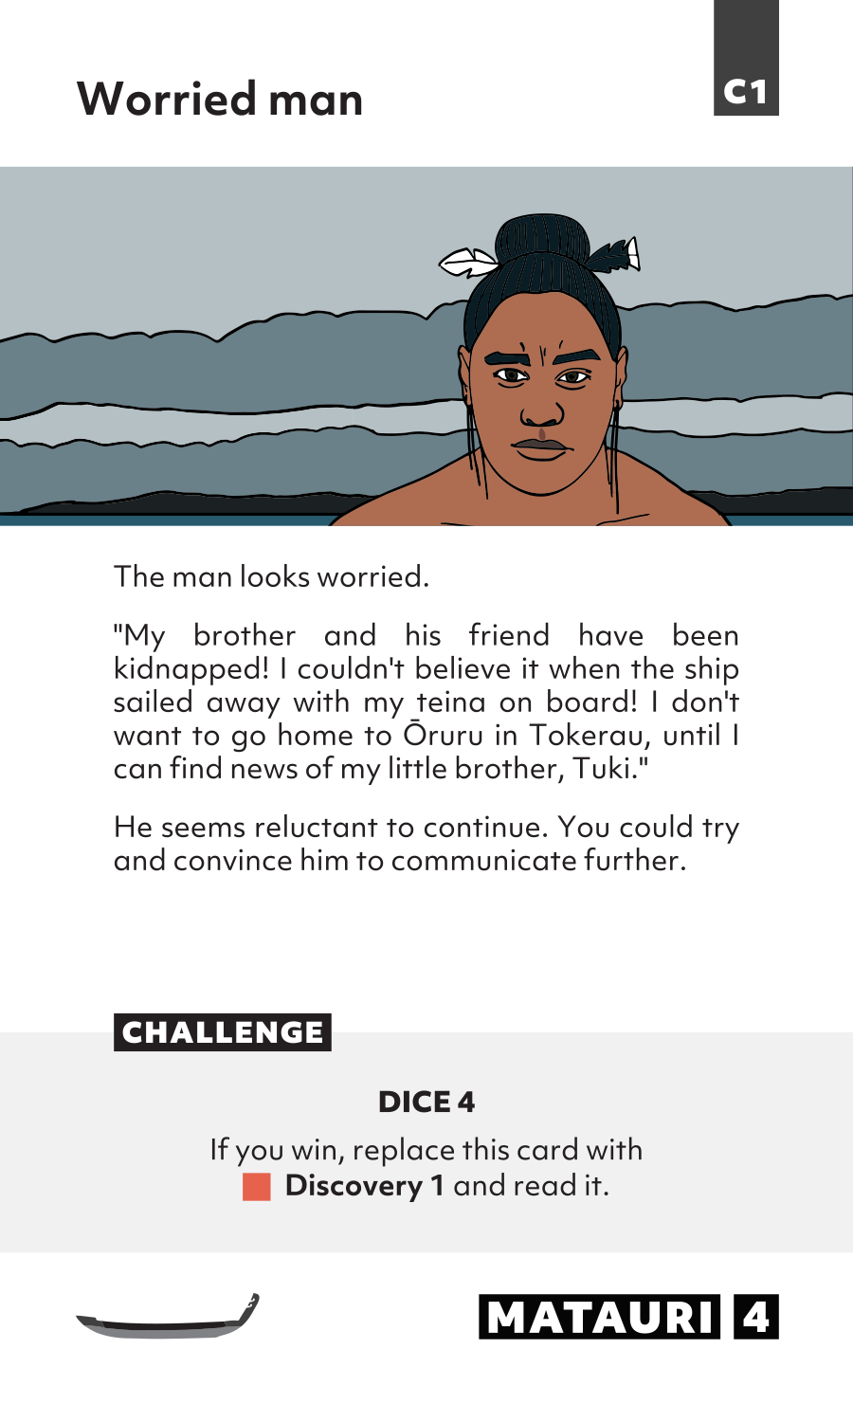
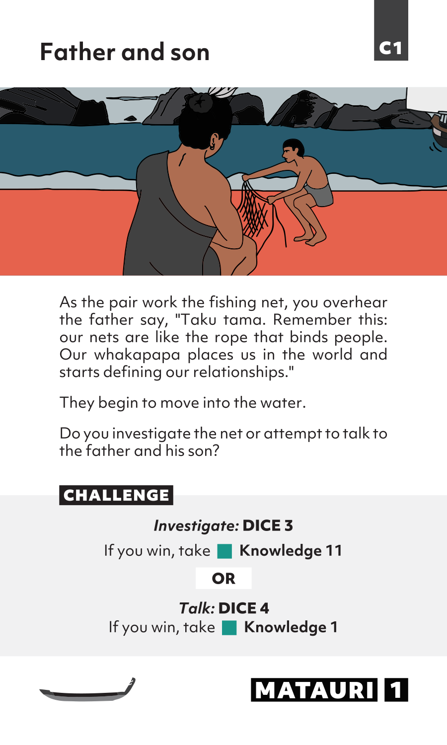
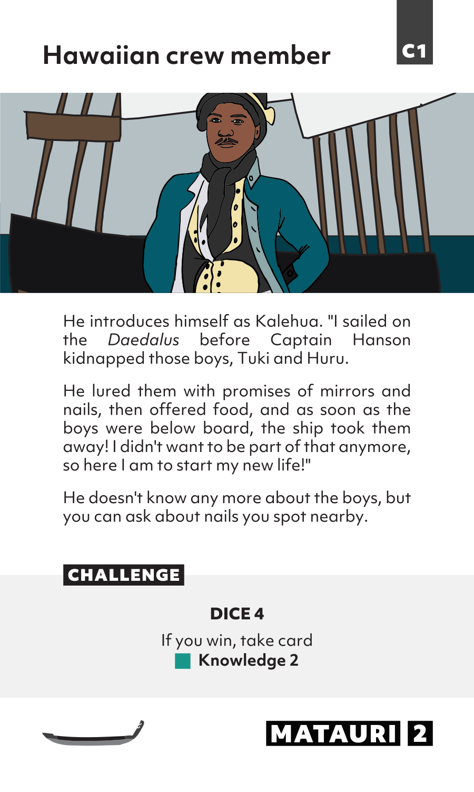
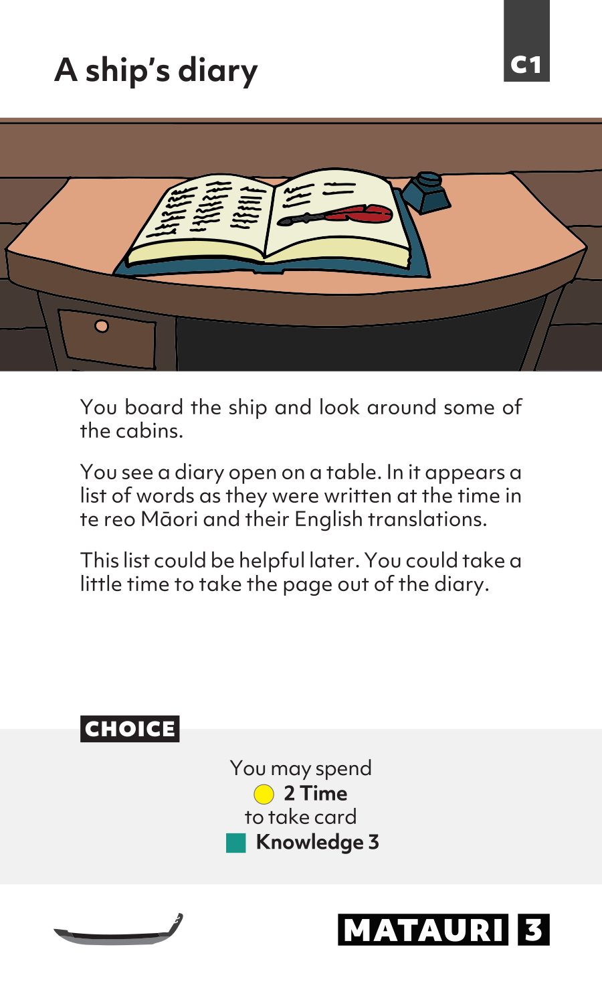
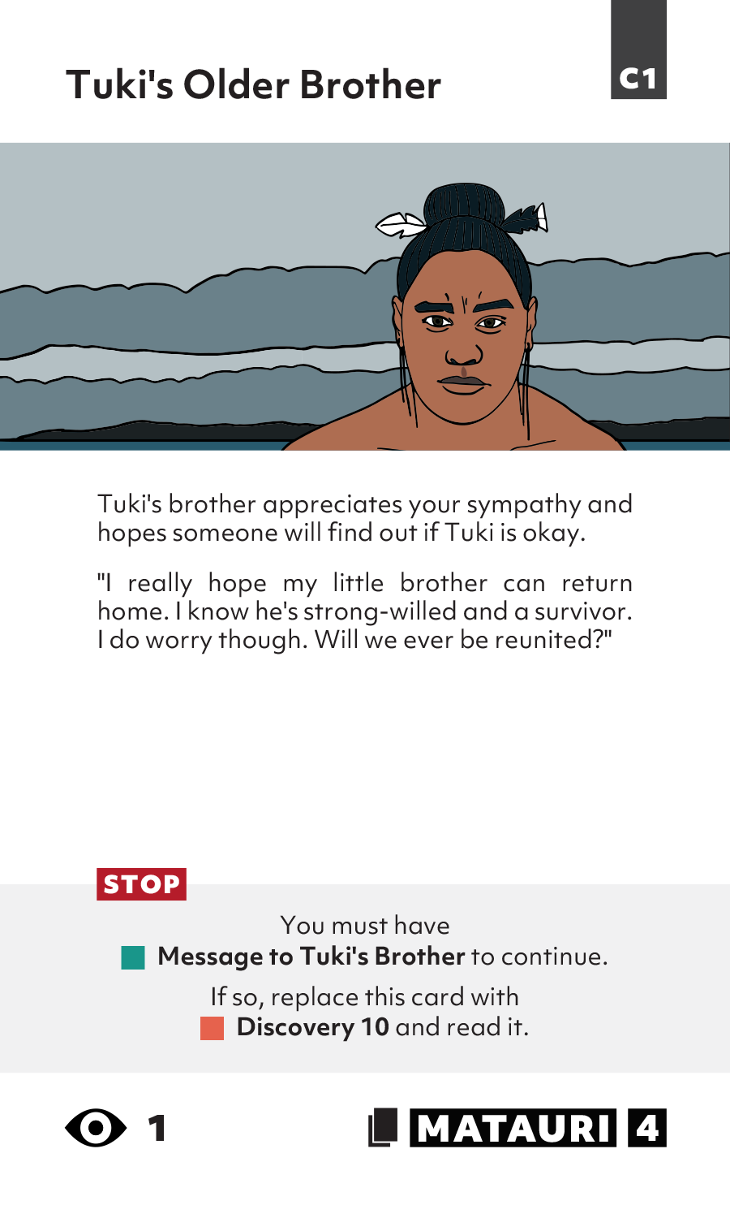
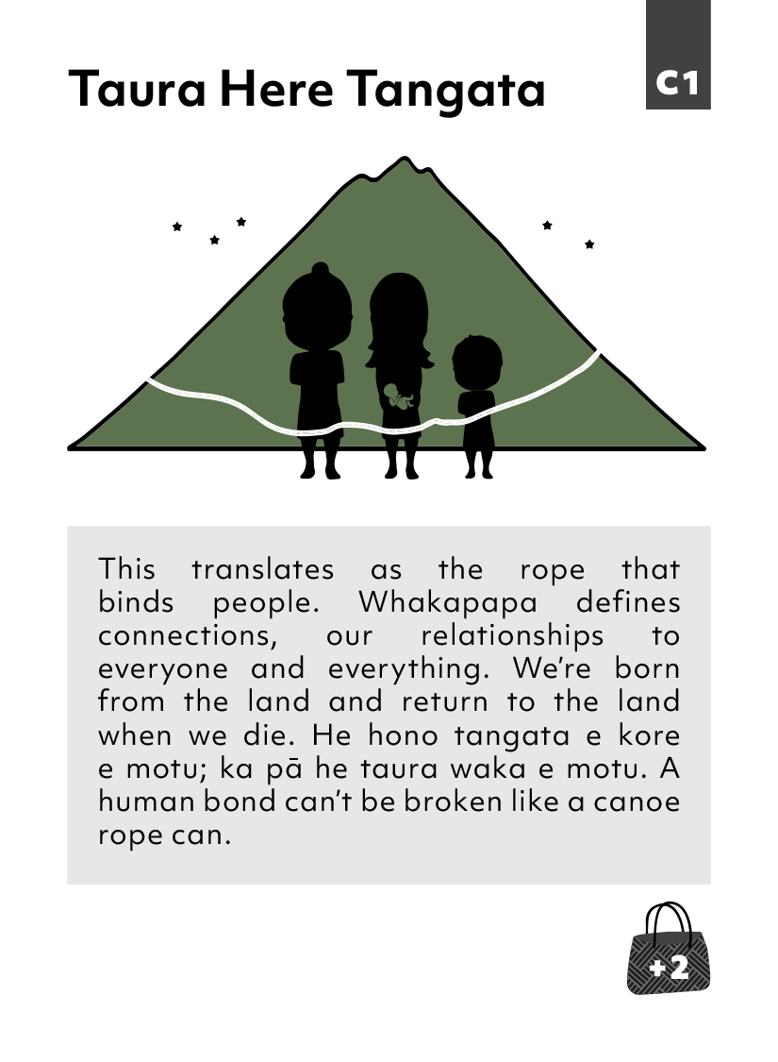
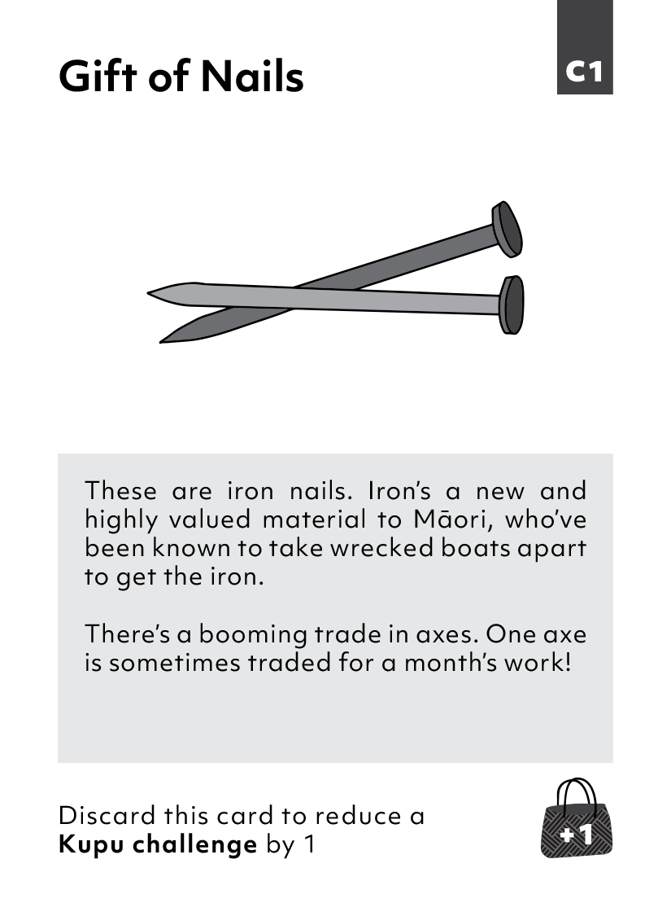
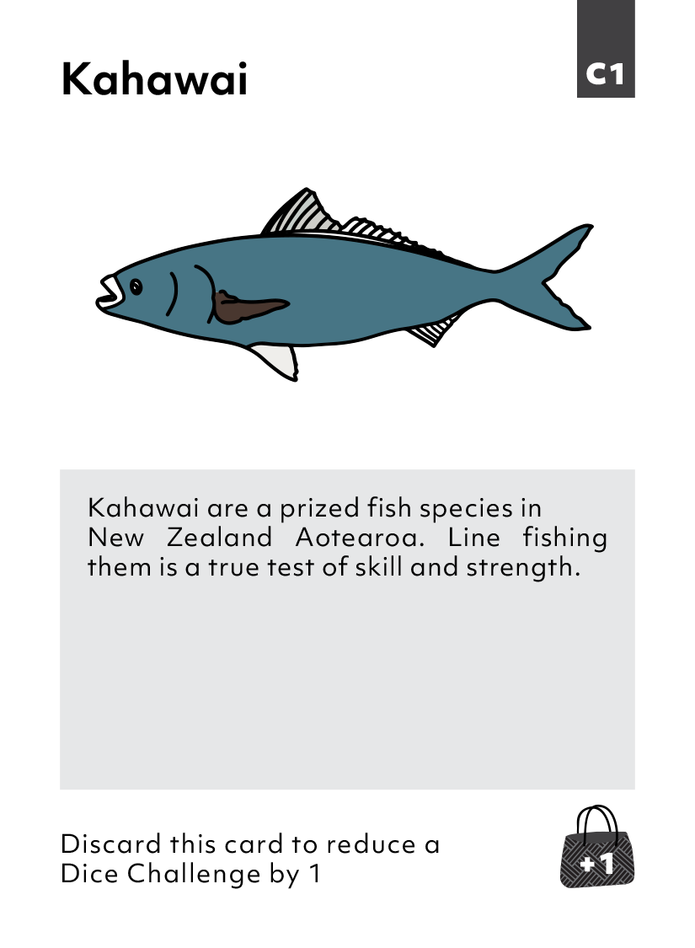
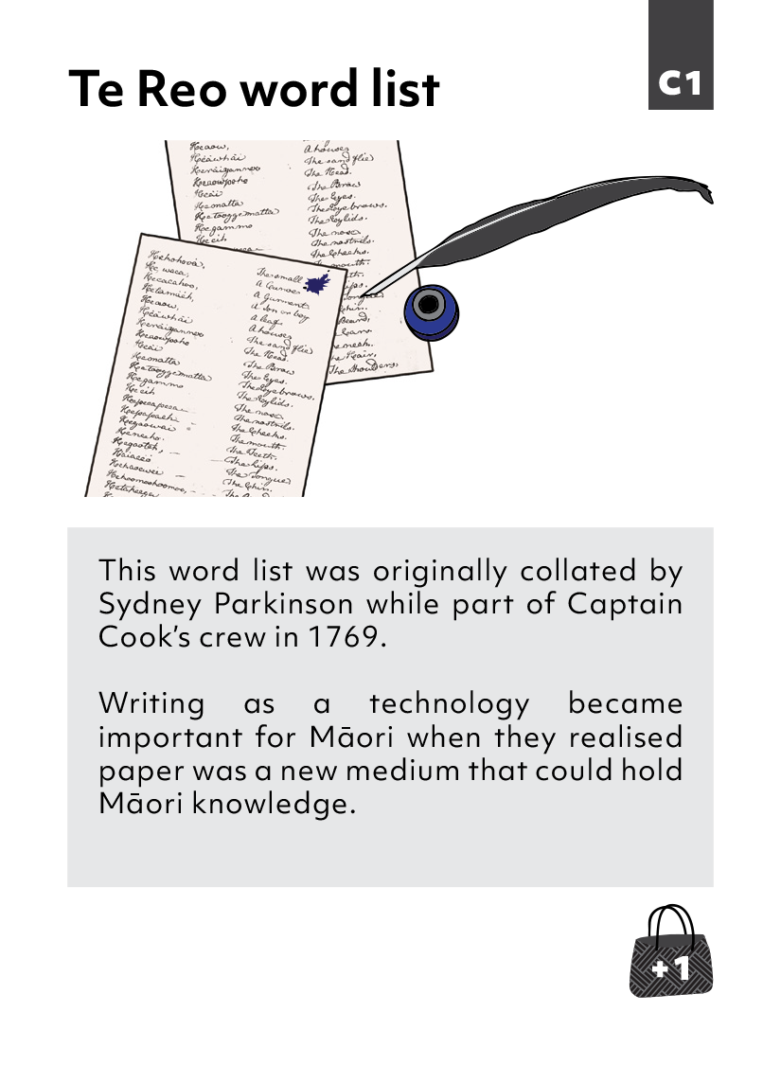
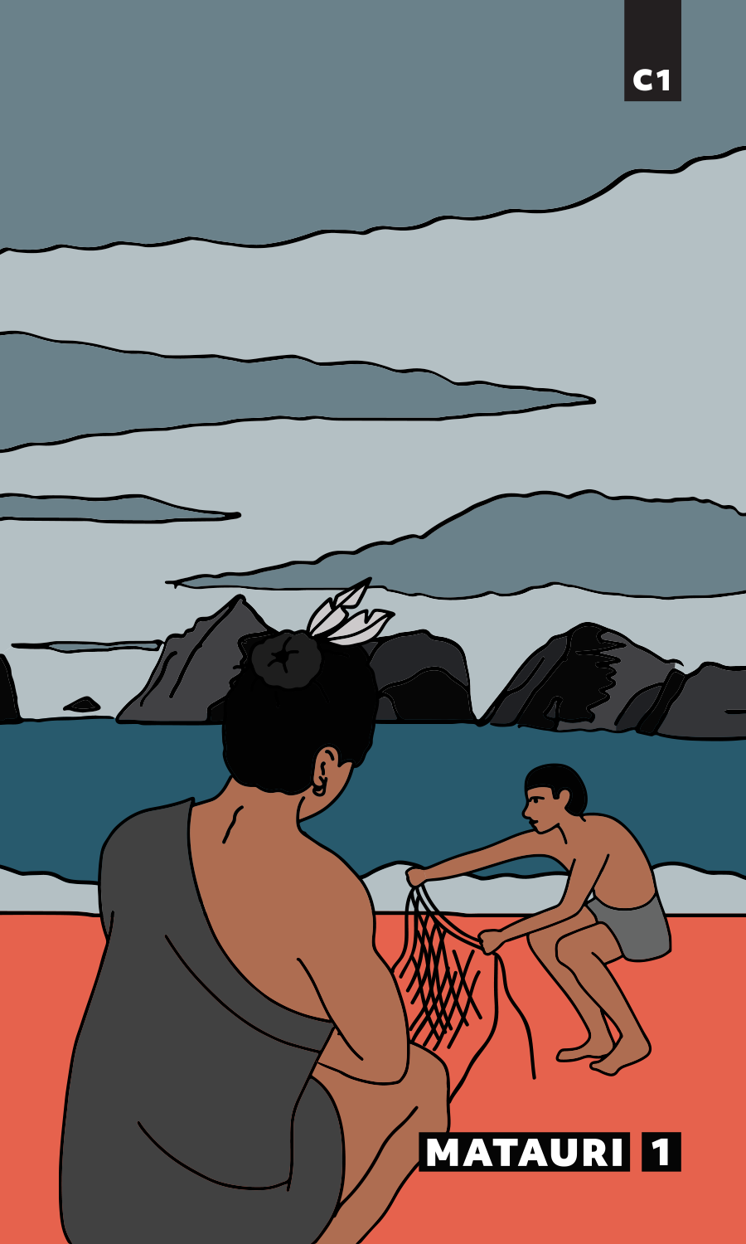
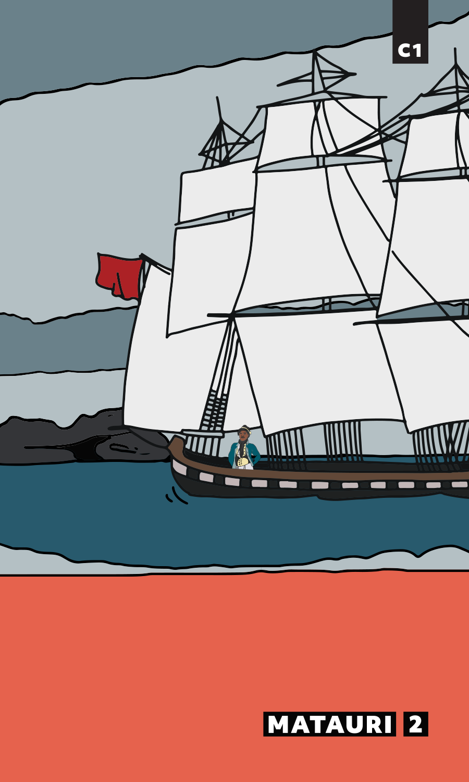
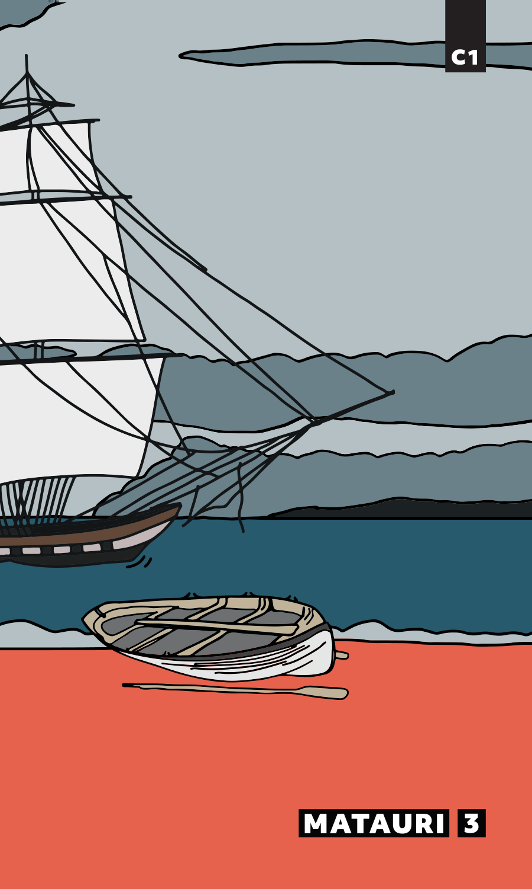
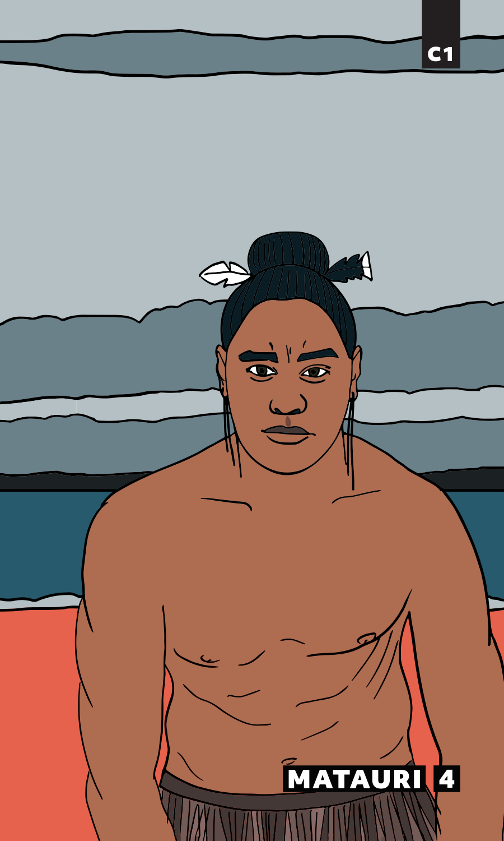





TE MOANA O MATAURI - MATAURI BAY

Slide 13
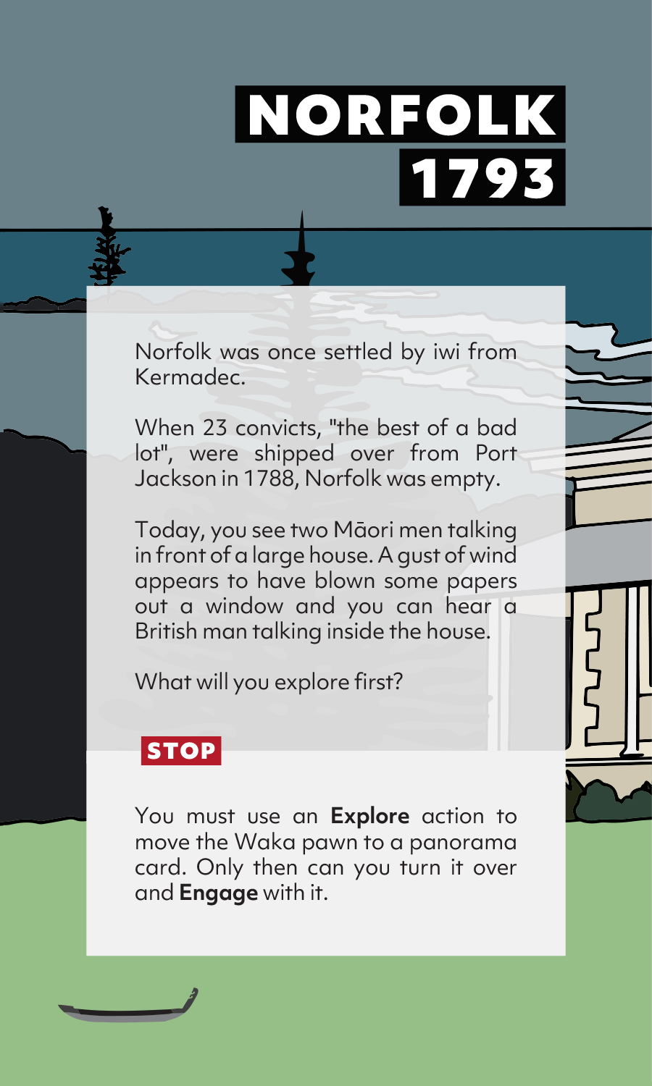
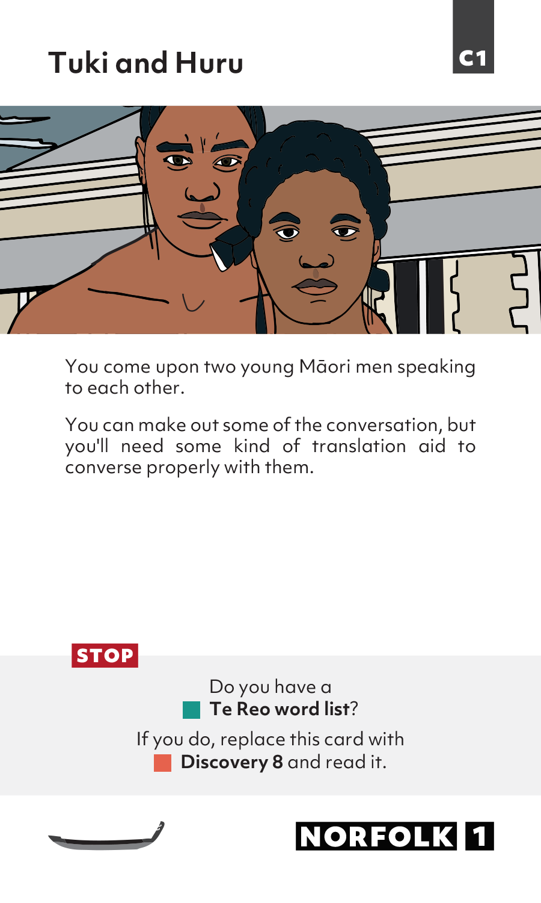
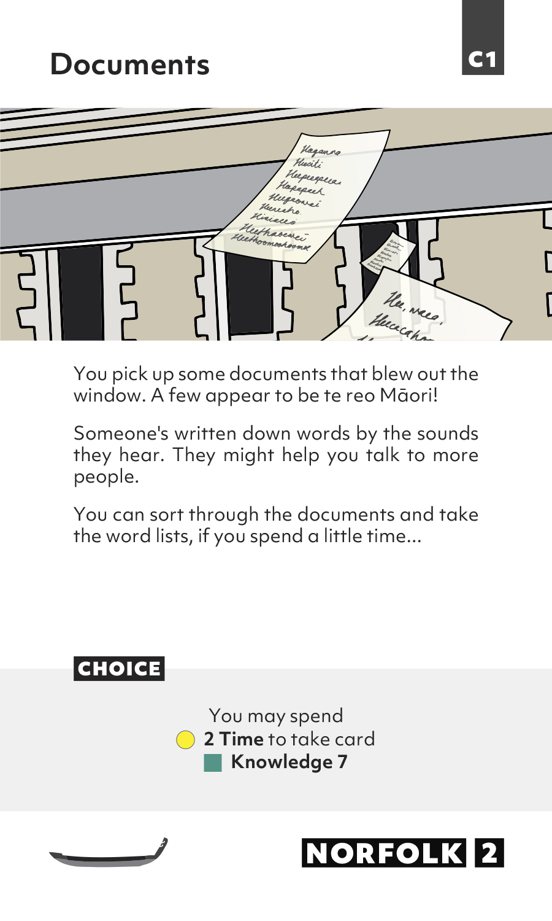
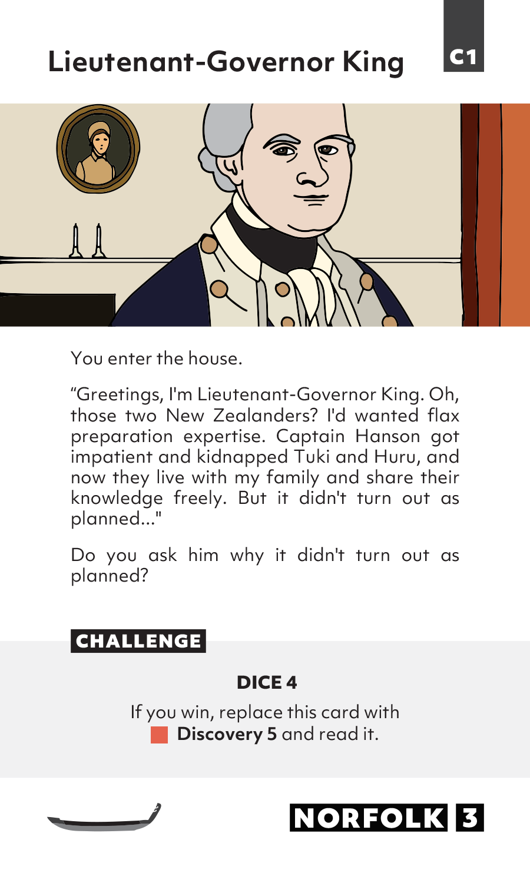
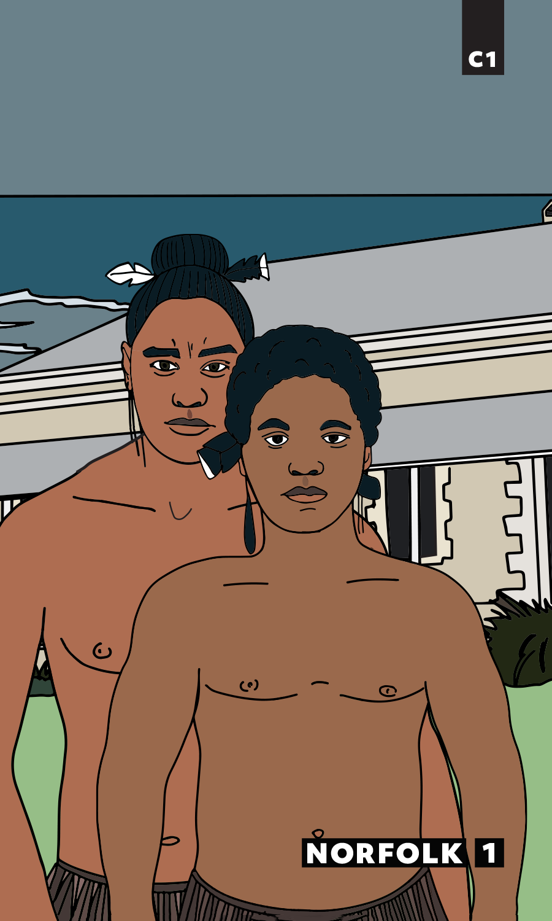
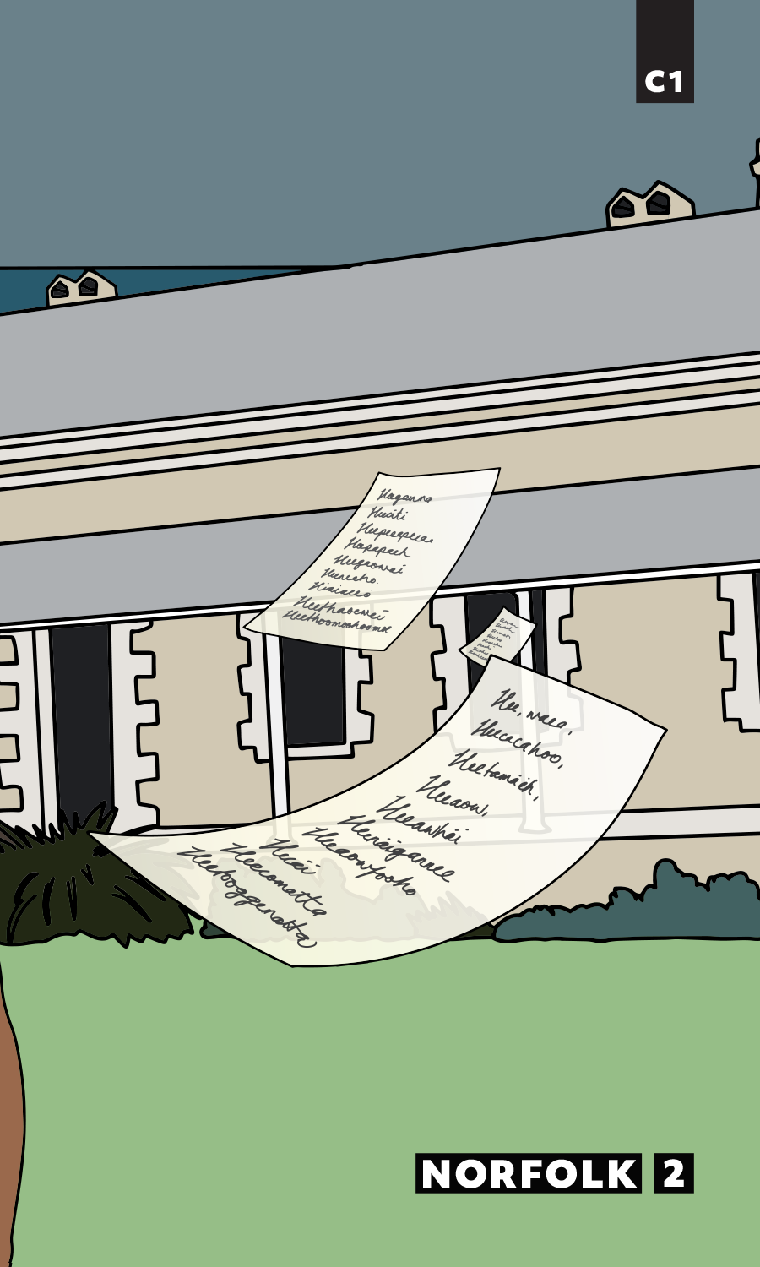
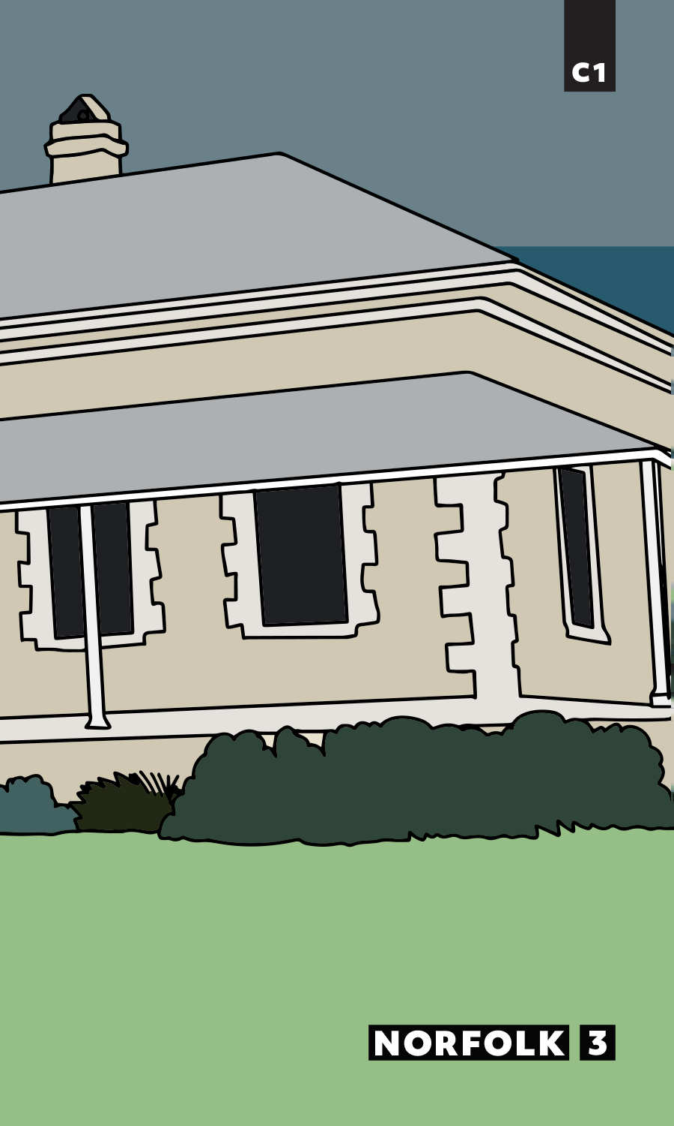
TE MOUTERE NŌPOKE – NORFOLK ISLAND

Slide 14
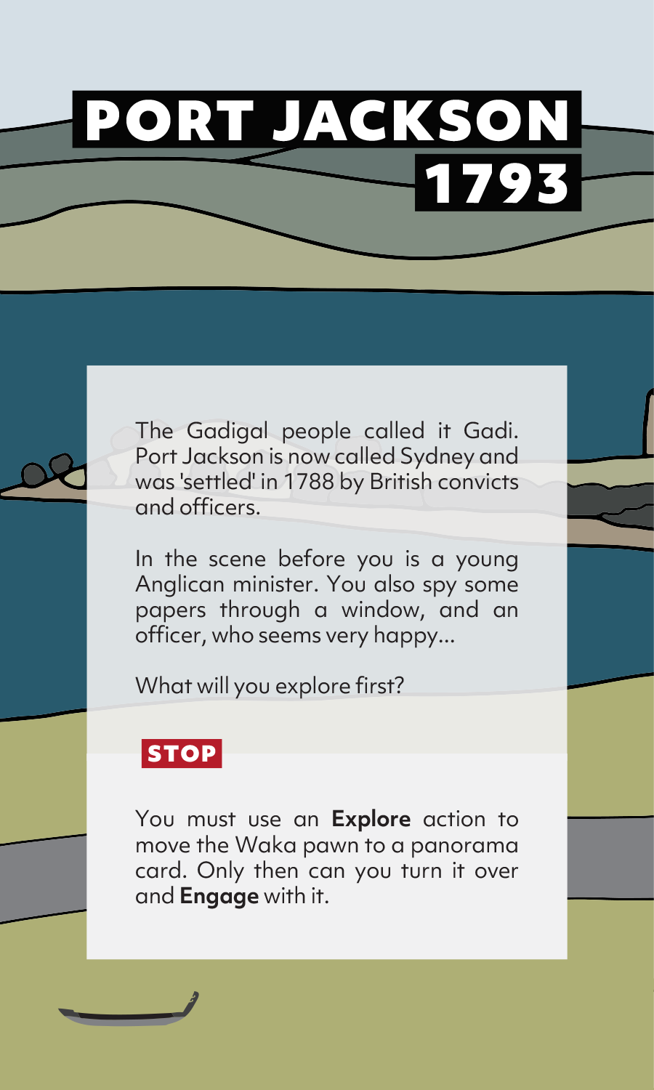
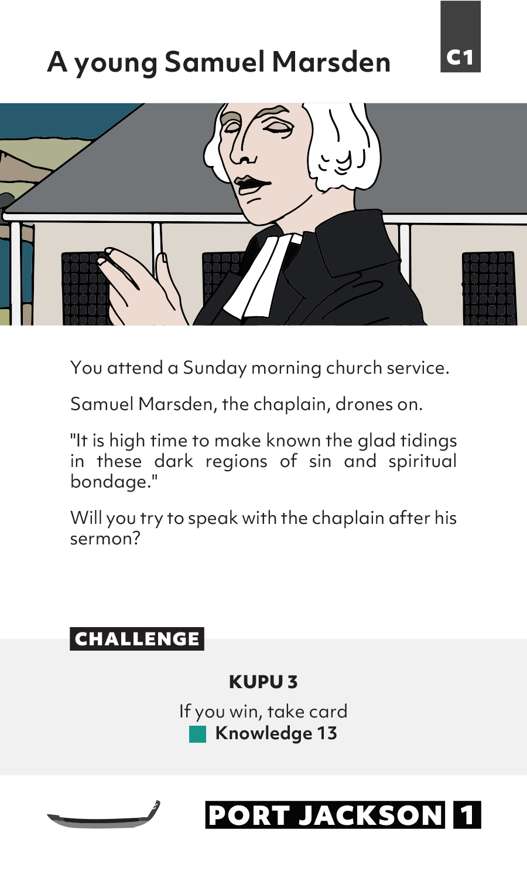
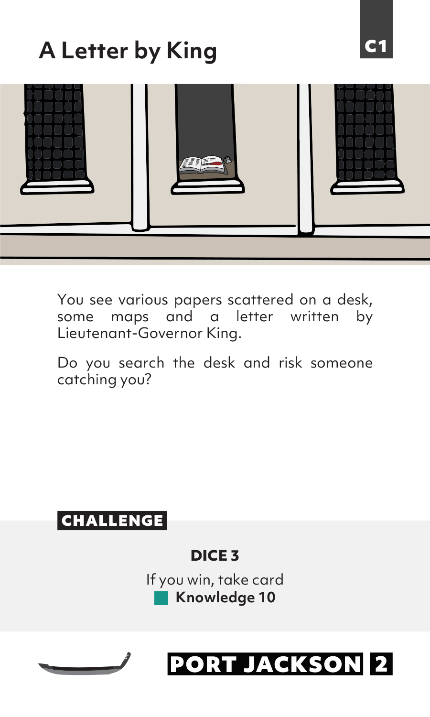
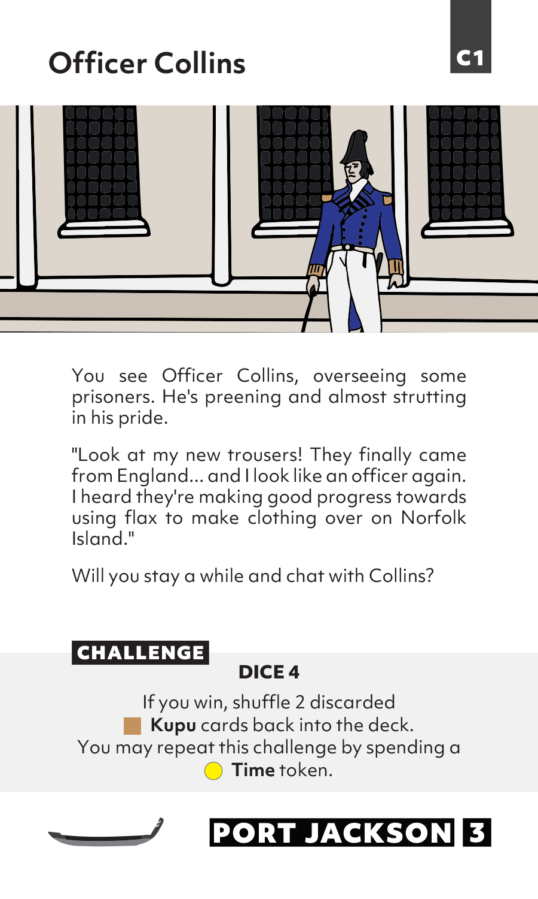
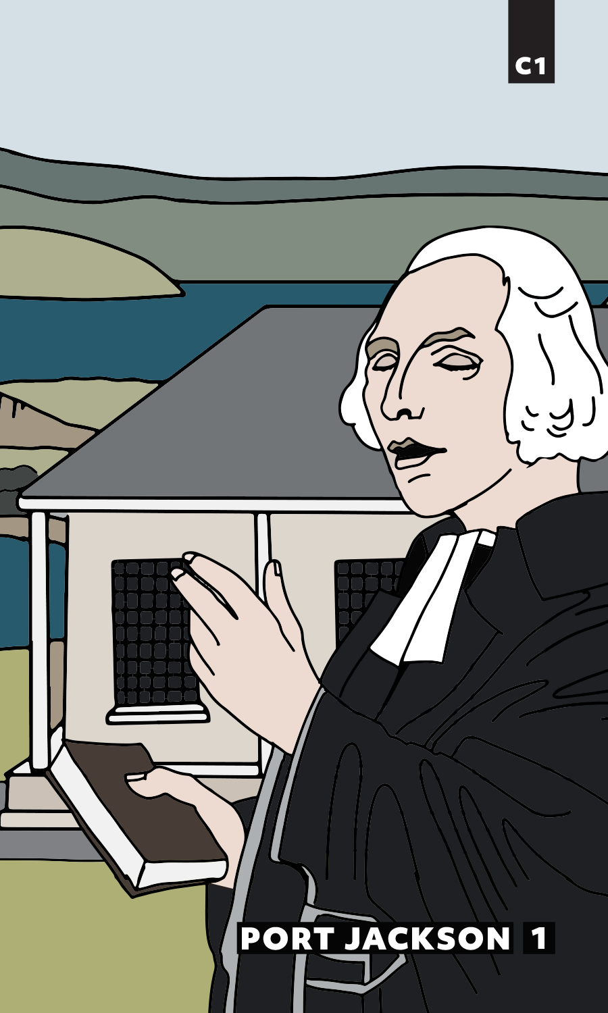
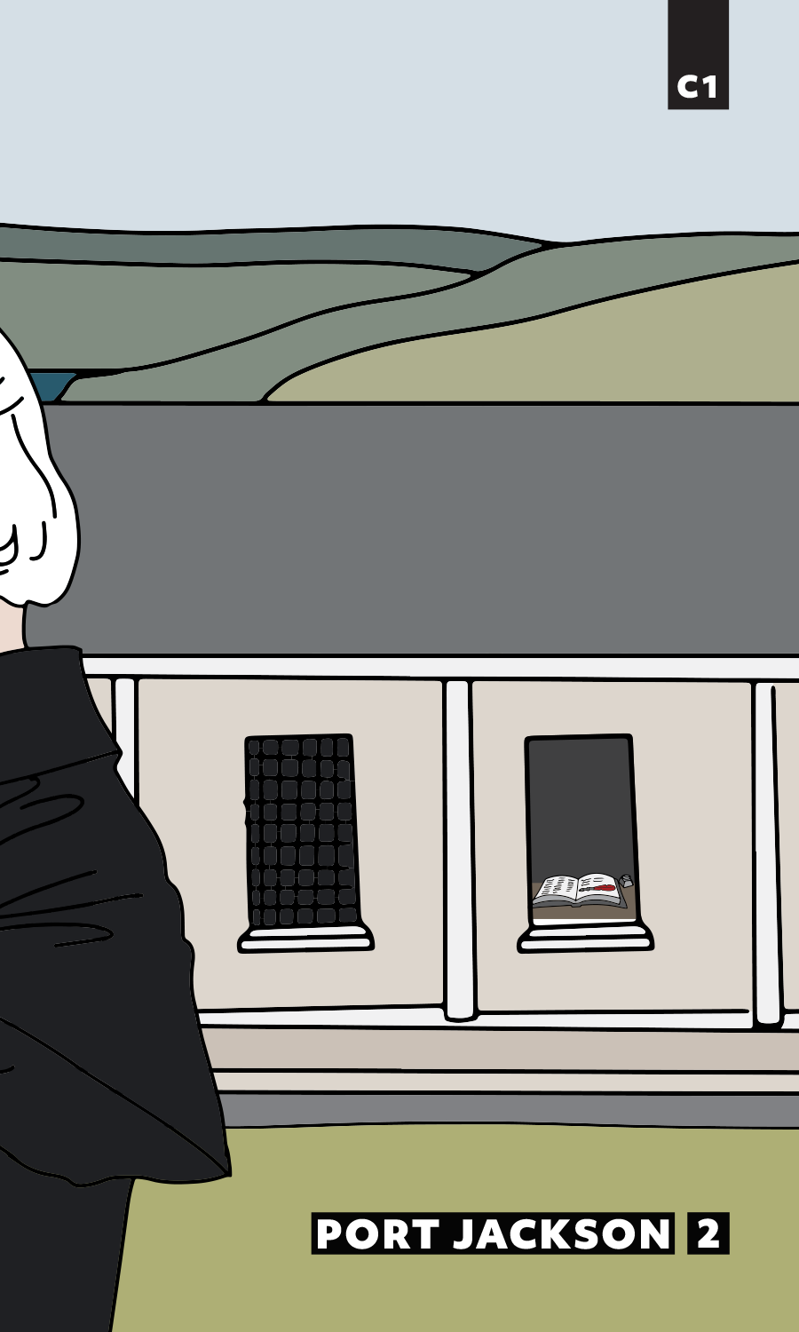
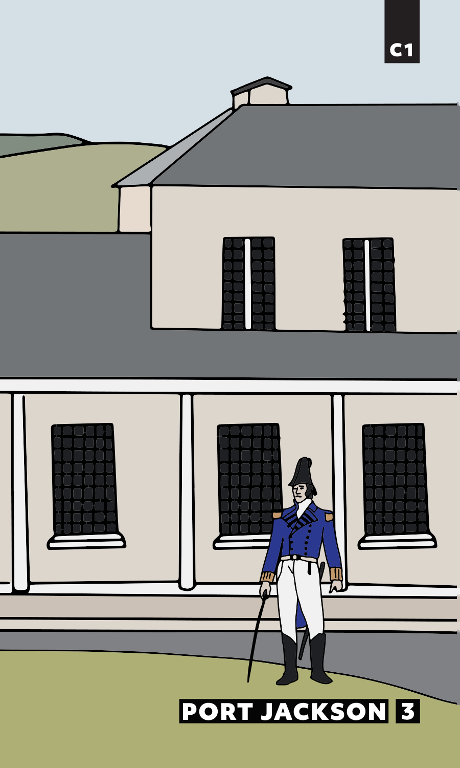
POIHĀKENA– PORT JACKSON

Slide 15
Learning game evaluation questions
How do my Learning Outcomes engage particular skills, or use knowledge?
Do the game actions students take embody parts of these skills to gain knowledge?
Are the players seeing the consequences of choices?
Do these consequences inform future decisions?
Alignment
Feedback

Slide 16
Possible design questions - for you or for students
Who am I, what am I trying to do, and why is it difficult?
(Establishes narrative and learning context)
I will do well in this game when I am able to…
(game outcomes that relates to learning outcome)
The “resources” or game states that change when I make decisions are…
(feedback)

Slide 17
Putting a game in your learning context
Before the game experience:
Establish the purpose of the experience in the flow of student learning.
During the game:
Use key moments to reflect on the experience in relation to the learning outcomes.
After the game:
Connect subsequent lessons back to the learning experience; or
Use the experience to illuminate further questions to explore.
Notes:
2 minutes

Slide 18
Introductions
What could “games in education” look like to you?
Notes:
5 minutes
https://bit.ly/3go0pJL

Slide 19


Thank you - Tēnā koutou
This game is inspired by the research of Alison Jones and Kuni Jenkins.
Consultant - Alison Jones
Translator - Stephanie Fong, Paetū Ltd
Translator - Jen Martin, Paetū Ltd
Kaumatua - Waldo Houia
Creator and Academic Lead- Ruth Lemon
Game Designer - Richard Durham
Game Developer - Minty Hunter, Nectarine
Senior Graphic Designer - Rebekah Farr, Nectarine
Graphic Designer - Lydia Menard, Nectarine
Illustrator - Rebekah Farr, Nectarine
The re-design and printing of the game was supported by contestable funding: the University of Auckland Learning Enhancement Grant 2017.

